Slide 2
Pilot Operational Perspective
on AI and Cyber security in Aviation

Slide 3
Pilot Operational Perspective on AI and Cyber Security
Remote Tower Services
Jamming & Spoofing
Reduce Crew Operation
Notes:
Introdurre I tre temi che verranno trattati nella presentazione

Slide 4
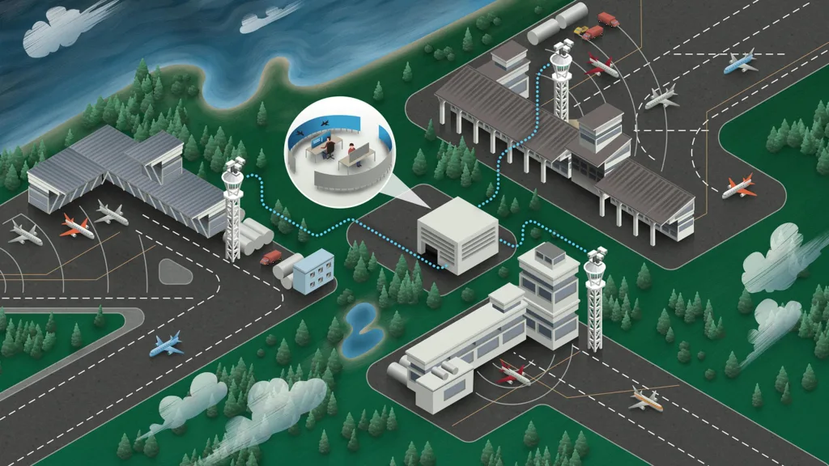
REMOTE TOWER SERVICE
Pilot Operational Perspective on AI and Cyber Security
Single Remote Tower
Multiple Remote Tower
Contingency Tower
Remote Towers can be operated from a
Remote Tower Centre potentially located anywhere
Notes:
• Single Remote Tower
› One air traffic controller is responsible for operations at one airport at a time. Yet,
he/she might hold multiple ratings to control different airports, one after the other.
• Multiple Remote Tower
› One air traffic controller is responsible for operations at more than one airport at
the same time. This requires multiple ratings for each controller and careful
staffing schedules. This concept is completely new compared to current
operations.
• Contingency Tower
› A contingency facility to be used when an airport tower is unserviceable for a short
period of time (e.g. fire, technical failure). Remote Tower operation will then
assure at least a basic level of service.
Remote Towers can be operated from a Remote Tower Centre (RTC) that can be located
anywhere, but is usually planned to be at a reasonable distance from all the airports to be
controlled in order to reduce latency of signals and increase technical reliability.

Slide 5
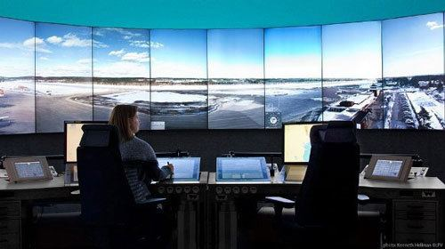
Pilot Operational Perspective on AI and Cyber Security
Remote Tower Service
Benefit:
Full ATS service allover
Whilst increasing the alertness of the controller.
The increased possibilities of presenting multiple data inputs are likely to lead to enhanced visual reproduction.
Remote contingency tower providing at least some level of service
Notes:
While the conventional concept of operating an ATC tower is proven to be safe in current day-to-day operations, the deployment of RTS does have potential safety benefits.
Smaller airfields currently only receiving Aerodrome Flight Information Service (AFIS) might be upgraded to fully controlled airfields. Other airports facing cutbacks due to low number of flight movements might still be able to provide ATS services, even if only for a limited time per day. The same is true for areas where destroyed infrastructure (e.g. after a fire) or an unstable safety situation (e.g. war zones) requires the quick set-up and operation of a control facility.
Modern RTS concepts include a number of tracking features. Aircraft position can be fllowed easily with a label attached next to the tracked target on the controller’s out-the- window screen, giving information on the call sign, altitude, and distance among others.
Ground staff and vehicles can be tracked, as well as birds and other animals or human intruders. Runway incursions can be automatically detected.
Whilst increasing the alertness of the controller, care has to be taken as not to overload the controller with too much information, leading to a situation where controllers develop a certain alarm-fatigue due to constant inputs. Task coordination needs to be carefully assessed, as controllers will probably spend more time “head-down”, concentrating on managing the systems (e.g. electronic flight strips) instead of actually watching movements.
The opposite may also be true at airports with very few movements, when performance of controllers and stimulation levels increase due to optimal workload distribution (Yerkes-Dodson law).
The increased possibilities of presenting multiple data inputs are likely to lead to enhanced visual reproduction, especially during twilight and night, as well as bad weather. The use of infrared cameras allows for weather assessment and target detection even during complete
darkness.
The idea of a remote contingency tower providing at least some level of service or the same service at a decreased movement rate is safety-wise beneficial compared to having to close an airport completely.
Having multiple controllers present in the same RTC might also lead to better coordination between ATS units.

Slide 6
Remote Tower Service
Pilot Operational Perspective on AI and Cyber Security
Adequate contingency procedures in case of hardware malfunctions (e.g. camera, controller working positions) and system downgrades shall be in place.
All aircraft systems, on-ground systems/networks and data transfers between aircraft and ground shall be protected from hacking, data manipulation and viruses.
Communication procedures and regulations for airspace design around RTS airports (e.g. transponder mandatory zones) shall be evaluated and changed where necessary.
Holding patterns, diversions or hazardous situations due to ATC staff shortages shall be avoided.
Ensure that real-time weather data and runway surface status is accurately assessed and transmitted to pilots.
Notes:
Cyber-security has become an increasing source of concern within the aviation community and remote tower operations have the potential to increase the vulnerabilities of the system given the very nature of the concept. Precautionary measures and contingency procedures shall be established to prevent an attack, and to minimise its consequences. ANSPs and aircraft operators shall establish a mandatory reporting system for cyber-related occurrences, and cyber security shall become an essential part of their security management system.
Traffic separation, especially for VFR flights is usually based on visual observation in conventional towers. Displays at RTS CWPs do not allow for visual evaluation of airborne aircraft positions. This is why the usage or radar data appears to be essential for RTS operation. This in turn might necessitate the need for transponder carriage by aircraft intending to use that airport. It has to be evaluated how far adjustments to current airspace design and specifications are necessary, e.g. mandating the use of transponders for all aircraft. General aviation aircraft are likely to be affected by revised rules.
From a pilot’s point of view there should be no changes to current operations. Yet, it might be necessary to revise communication procedures and charting requirements. Especially in a Multiple RTS environment, the re-transmit function that allows users to listen to radiotelephony on multiple frequencies might be a feature to ensure safe operations.
Mentioning the airport’s name in clearance (e.g. cleared to land runway 20 Dresden) might be another option of avoiding misunderstandings.
Coordination between airspace users and ANSPs will have to be increased to accommodate all aircraft movements, be they planned or unplanned. As in today’s ATC environment, staff shortages may happen. While this is usually a problem in the en-route part of flights today, availability of tower controllers might be the limiting factor in RTS operations, with not enough staff available to cater for all flights. Unexpected flights such as VFR traffic or flights that have to land due to emergencies or diversions might push the remotely controlled tower even
further beyond capacity. While slot allocations or per-prior-request-only operations might counteract such problems, there is a clear shift of responsibility for safety from ANSPs to pilots and operators. It is not acceptable that unavailability of tower controllers leads to hazardous situations.
It is air traffic controllers who nowadays often do weather assessment and the evaluation of the runway surfaces status. In case of RTS operations these would have to be performed by dedicated staff or adequate systems and sensors. It is also questionable how far weather
assessment can be done by RTS controllers when being presented with a compressed or limited view of the airport. The quality of reports must not be lower than in today’s environment. implications on daily operations are yet fully understood. It would be advisable to first evaluate experience of prolonged live Single RTS, before establishing Multiple RTS. There are currently no long-time studies on how human performance is affected in Remote Tower operations and current results indicate that there are certain limitations for humans with regards to working in an RTS environment.
Nowadays only few air traffic controllers hold ratings for more than one tower and it is highly unlikely that these would be exercised in a single shift. In Multiple RTS controllers might berequired to work at airports with completely different or very similar layouts and weather patterns. Both can lead to a fragmented situational awareness, causing misunderstandings, mix-ups and other working errors, thus having the potential to significantly decrease the safety of operations. Competency of controllers to evaluate the situation at a specific airport might also decrease with increased workload and numerous distractions. Studies have shown that head-down time increases in a Multiple RTS environment. Other factors like usage of a common frequency or aligning procedures and airport markings have not been studied yet.
The concept of RTS fundamentally changes the working environment of tower controllers and different procedures and techniques have to be used. This is especially true for Multiple Tower operations. While research has shown that the concept can generally work, not all…

Slide 7
Remote Tower Service
Pilot Operational Perspective on AI and Cyber Security
CLOSE NETWORK
CONTINGENCY
Notes:
In Multiple RTS controllers might be required to work at airports with completely different or very similar layouts and weather patterns. Both can lead to a fragmented situational awareness, causing misunderstandings, mix-ups and other working errors, thus having the potential to significantly decrease the safety of operations. Competency of controllers to evaluate the situation at a specific airport might also decrease with increased workload and numerous distractions. Studies have shown that head-down time increases in a Multiple RTS environment. Other factors likeusage of a common frequency or aligning procedures and airport markings have not been studied yet.

Slide 8
Remote Tower Service
Pilot Operational Perspective on AI and Cyber Security
Rising the awareness on the risk related
Promoting a coherent flight planning on alternate and destination.
Acting together with all the stakeholder to better enhance the concept

Slide 9
Remote Tower Service
Pilot Operational Perspective on AI and Cyber Security
Until sufficient experience with Single RTS has been gained and until human factors and technical implications have been thoroughly researched and are adequately mitigated to ensure safe ATC operations.
Until a legal EU framework is in place to effectively prevent regulatory forum shopping and market distortion.
IFALPA – ECA - ANPAC currently DO NOT support implementation of Multiple RTS or cross-border RTS

Slide 10
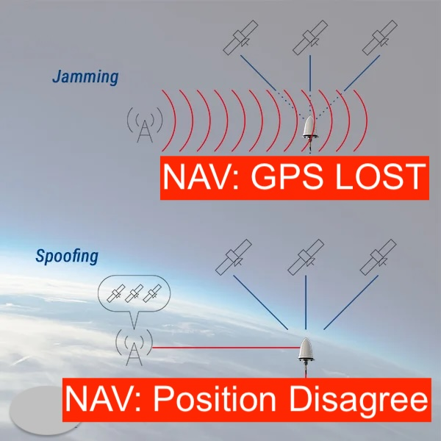
JAMMING & SPOOFING
Pilot Operational Perspective on AI and Cyber Security
NO WARNING
TO PILOTS

Slide 11
Pilot Operational Perspective on AI and Cyber Security
Jamming & Spoofing
JAMMING
is a kind of “white noise” interference, causing loss of accuracy and potentially loss of positioning. This type of interference can come from adjacent electronic devices or external sources.
SPOOFING
is an intelligent form of interference which fools the user into thinking that he/she is in a false location. For example, in a spoofing attack, a nearby radio transmitter sends fake GPS signals to the target receiver.
Notes:
A CLEAR EXPLANATION ON THE DIFFERENCE.

Slide 12
Pilot Operational Perspective on AI and Cyber Security
Jamming & Spoofing
1. LOSS OF GPS AS THE NAVIGATION SOURCE:
Loss of GPS can affect the aircraft's navigation accuracy and integrity. This can affect the Performance-Based Navigation (PBN) requirements, and thus, prevent the aircraft from flying certain routes, terminal areas or RNP approaches. Moreover, modern aircraft communication systems may be lost; e.g. CPDLC, ADS-B, ADS-C.
2. MISLEADING POSITIONING:
Malicious actors may spoof misleading position data into the navigation system, potentially causing the aircraft to deviate from its intended route.

Slide 13
Pilot Operational Perspective on AI and Cyber Security
Jamming & Spoofing
3. APPROACH AND LANDING HAZARDS
Manipulated signals during critical phases of flight, such as approach and landing, can lead to unstable approaches or missed approaches, increasing the risk of accidents.
4. SPURIOUS WARNINGS
Some aircraft systems utilize the GPS position directly. For example, the predictive modes of EGPWS/TAWS may trigger false warnings as they are fed directly with the raw GPS position.
Notes:
In many aircraft avionics architectures, the FMS position utilizes both the IRS and GPS to ensure the highest accuracy. Losing the GPS signal, the FMS would continue to use the IRS and its last known position. When in range of radio navigation devices (e.g. VOR, DME), it would utilize these to enhance the IRS location.
However, some avionics architectures feed the GPS position directly into position computation. This may result in discarding the IRS position for navigational purposes, and/or utilizing directly the spoofed GPS location for location determination. Thus, these systems are highly susceptible to GPS spoofing attacks.

Slide 14
Pilot Operational Perspective on AI and Cyber Security
Jamming & Spoofing
Rising the awareness on the risk related
Explaining the technology to pilots
Suggest some countermeasures

Slide 15
A Pilot Operational Perspective Jamming & Spoofing
In many aircraft avionics architectures, the FMS position utilizes both the IRS and GPS to ensure the highest accuracy. Losing the GPS signal, the FMS would continue to use the IRS and its last known position. When in range of radio navigation devices (e.g. VOR, DME), it would utilize these to enhance the IRS location.
However, some avionics architectures feed the GPS position directly into position computation. This may result in discarding the IRS position for navigational purposes, and/or utilizing directly the spoofed GPS location for location determination. Thus, these systems are highly susceptible to GPS spoofing attacks.

Slide 16
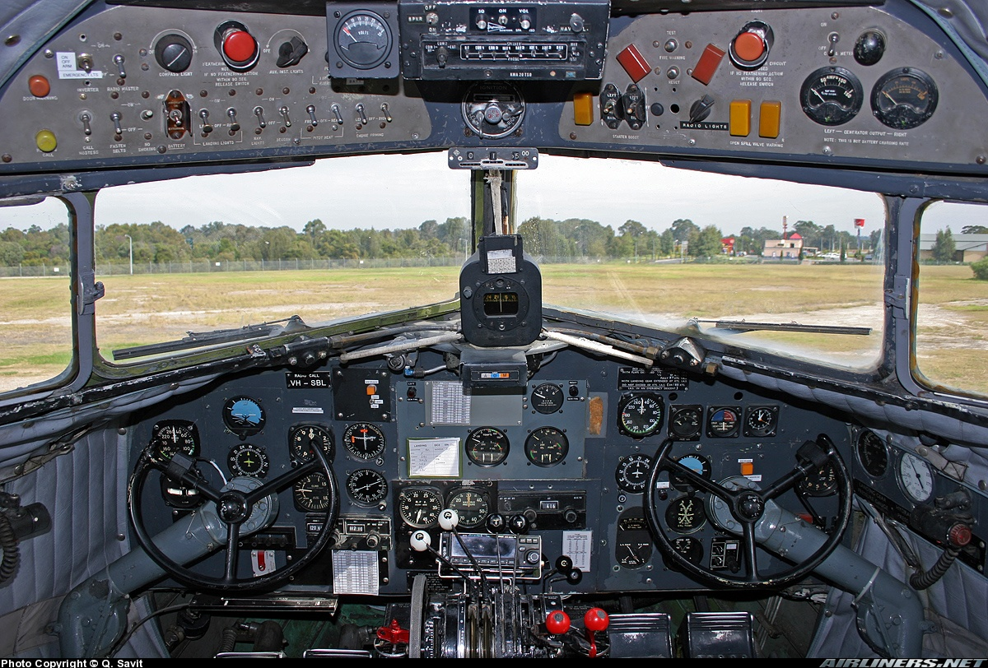
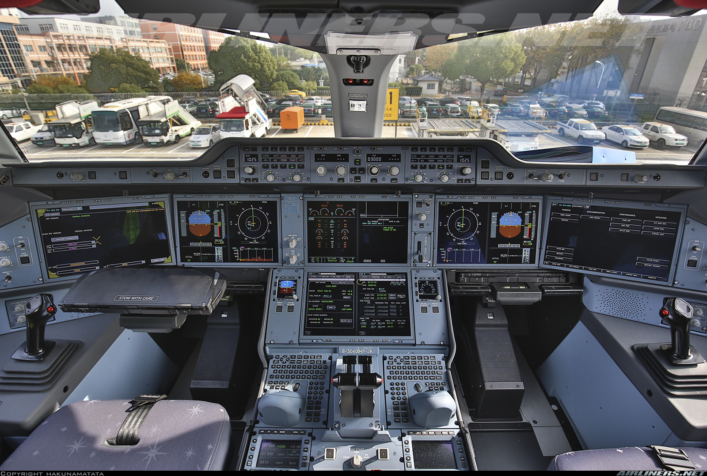
Pilot Operational Perspective on AI and Cyber Security
ANY SIMILARITY ?
DC 3
A-350
WINDOWS & DOUBLE SET OF CONTROLS
TWO PILOTS
Notes:
L’idea è di catturare l’attenzione della platea mettendo a confronto le due foto. Aspettare/accettare minimo 10 secondi (di silenzio) prima di dire qualcosa (sicuramente qualcuno dell’audience romperà il silenzio e risponderà). Una volta che si sono ricevute un po’ di risposte far notare che come la tecnologia sia cambiata/avanzata ma solo due cose sono rimaste uguali: i finestrini per vedere fuori e i controlli doppi. Questo perché ancora oggi i piloti sono centrali/essenziali nel pilotaggio degli aerei! Sembra una banalità o una provocazione ma non lo è…vedere la prossima slide per maggiori info.
The idea is to capture the audience attention by comparing the two picture. Wait/allow minimum 10 second (of silence) before saying anything. (it has been studied that human being cannot stand silent and in 10sec someone from the crowd will say something). After the audience has given some answers, steer the conversation towards the fact that despite the technology has advance enormously, two element are the same: cockpit windows and double set of control. This is because pilots are still central/essential to conduct a safe flight. It might seems obvious but it is not….check the next slide for more info

Slide 17
Pilot Operational Perspective on AI and Cyber Security
REDUCED CREW OPERATIONS
reduction of the number of PILOTS from the flight deck
Extended Minimum Crew Operations (eMCO)
only one pilot would be required to remain at the controls during cruise while the other pilot would be resting outside the flight deck
Single Pilot Operations (SiPO)
only be one pilot onboard at any given time during flight, also during critical phases of flight such as take-off and landing
Notes:
Explain the manufacturer industry is pushing for a RCO. Explain the two different type of RCO…and the ask this questions as provocation:
«IF YOU THINK THAT WHAT YOU HAVE SEEN SO FAR (GPS spoofing, etc etc) IS A THREAT…IMAGINE IF THAT HAPPENS IN A COCKPIT WITHOUT TWO PILOT…»
Go to next slide to elaborate more…
Spiegare il significato di RCO e le differenti opzioni…poi chiedere la seguente domanda come provocazione:
«IF YOU THINK THAT WHAT YOU HAVE SEEN SO FAR (GPS spoofing, etc etc) IS A THREAT…IMAGINE IF THAT HAPPENS IN A COCKPIT WITHOUT TWO PILOT…»
Andare alla seguente slide per elaborare il concetto…

Slide 18
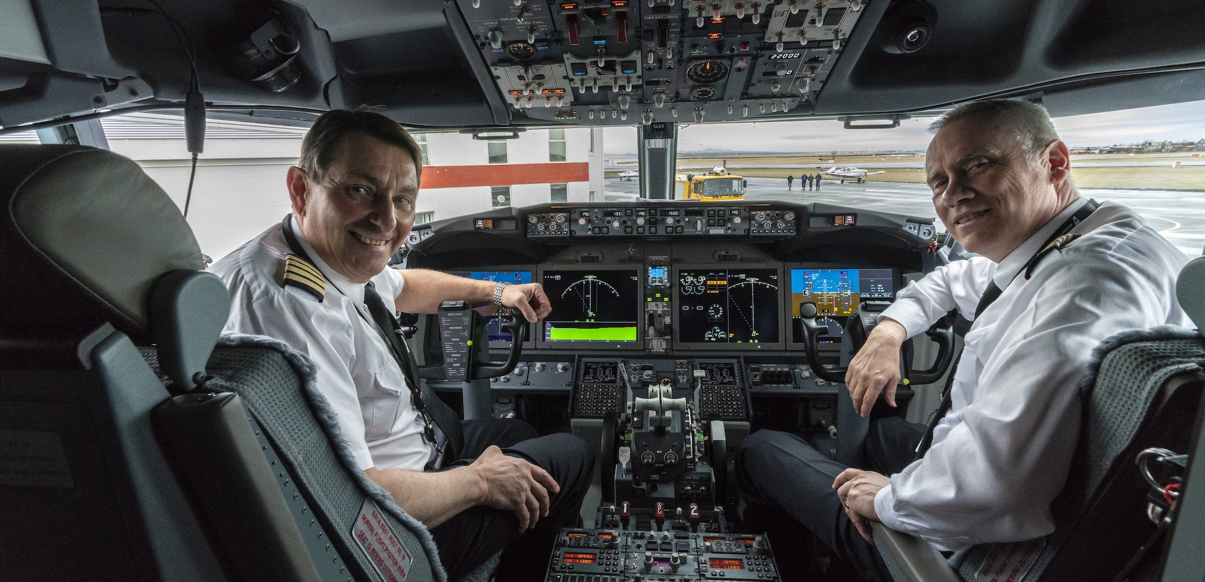
SAFETY
BARRIER
System-faliure scenario
Cyber attack
Incapacitation on single pilot
Insider Threat
Adapt in real time/environment
Adopt non-aticipated solution
Critical on-board backup
Last line of defence
FLIGHT CREW form the LAST LINE OF DEFENSE against fatal consequences of a cyber-attack on the aircraft or airspace infrastructure.
Notes:
Start with the list of risks…than emphasise the pilot as essential safety barrier!
Computers can do certain things better than humans, but they are only as good as their system design. Taking the human pilot out of the loop removes a significant safety resource.
Humans eliminate system-failure scenarios and act as a critical onboard backup for failed systems, bridge technology-gaps and adapt in real-time and in the real environment to
non-anticipated situations. Whether an automated system can adequately compensate for this is highly questionable. Additionally, with the reduction of input by human pilots, the risk of system associated threats increases.
WHILE A LOT OF ACCIDENT AND INCIDENT STATISTICS DOCUMENT HOW OFTEN THINGS GO WRONG, THERE IS ALMOST NO DATA ON WHEN THINGS GO RIGHT, AND PILOTS SAVE THE DAY.
flight crew currently form the last line of defense against the potentially fatal consequences of a cyber-attack on the aircraft or airspace infrastructure.

Slide 19
Pilot Operational Perspective on AI and Cyber Security
SAFETY
BARRIER
System-faliure scenario
Cyber attack
Incapacitation on single pilot
Insider Threat
Adapt in real time/environment
Adopt non-aticipated solution
Critical on-board backup
Last line of defence
FLIGHT CREW form the LAST LINE OF DEFENSE against fatal consequences of a cyber-attack on the aircraft
Notes:
Start with the list of risks…than emphasise the pilot as essential safety barrier!
Computers can do certain things better than humans, but they are only as good as their system design. Taking the human pilot out of the loop removes a significant safety resource.
Humans eliminate system-failure scenarios and act as a critical onboard backup for failed systems, bridge technology-gaps and adapt in real-time and in the real environment to
non-anticipated situations. Whether an automated system can adequately compensate for this is highly questionable. Additionally, with the reduction of input by human pilots, the risk of system associated threats increases.
WHILE A LOT OF ACCIDENT AND INCIDENT STATISTICS DOCUMENT HOW OFTEN THINGS GO WRONG, THERE IS ALMOST NO DATA ON WHEN THINGS GO RIGHT, AND PILOTS SAVE THE DAY.
flight crew currently form the last line of defense against the potentially fatal consequences of a cyber-attack on the aircraft or airspace infrastructure.

Slide 20
Pilot Operational Perspective on AI and Cyber Security
2 PILOTS + AI = ENACHED SAFETY
IFALPA – ECA - ANPAC
currently DO NOT support reduced or
single pilot operations in Commercial Aviation
Notes:
This slide is to stress the concept that we are not against technilogy but we want technology to work alongside with the humans. Increased use of automation in commercial aircraft, and eventually certification of Artificial Intelligence (AI) for the use in this environment, should have as a goal enhancement of human capacity, and not its replacement. This in return would increase efficiency and most importantly enhance Flight Safety.

